Slide 1
FYP Progress UPDATE 1
Li Pian

Slide 2
Research Title Suggestion
Research on the Performance of Digital Signal Processing in Financial-markets Prediction

Slide 3
Objective
This Final Year Project aims to investigate the application of digital signal processing in stock-market prediction. The advantages and disadvantages of different methods will be discussed regarding different types of stock. The final deliverable will be a user-friendly interface which allows the user to examine the predictive value of the stock price using different digital signal processing approaches.

Slide 4








Scope
Research on DSP
Performance
Optimization
Method and stock type comparison
Interface
Implementation

Slide 5
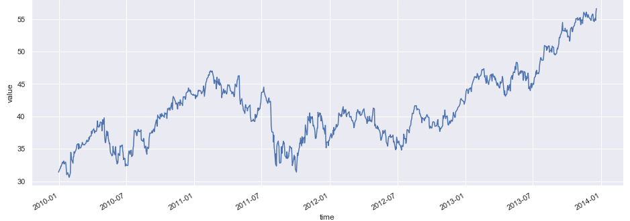
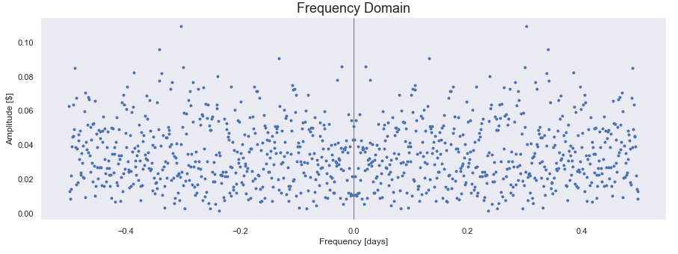
Progress From Week 2 to Week 5
Dataset Source:
Emerson Electric Co. (EMR) ,
Yahoo Finance
Graph of thEmerson Electric Co. (EMR)e stock(EMR) adjusted closing price ranging from 2010-01 to 2014-01
Conducted Fast Fourier Transform on the daily adjusted closing price differences, the superposition values of frequency vs amplitude plotted

Slide 6
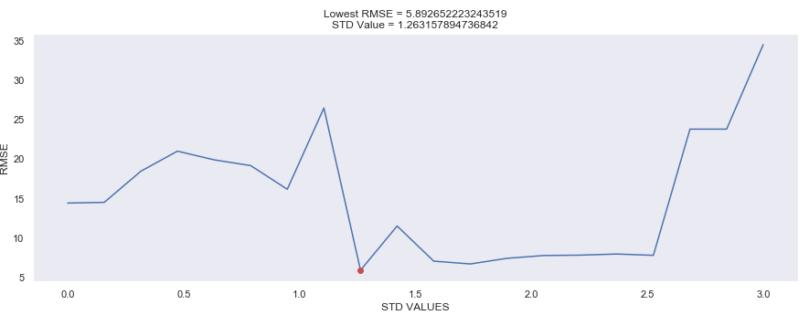
Progress From Week 2 to Week 5
To optimize the prediction, an algorithm aiming to find fittest standard deviation coefficient used.
Minimum RMSE obtained when standard deviation coefficient is 1.26

Slide 7
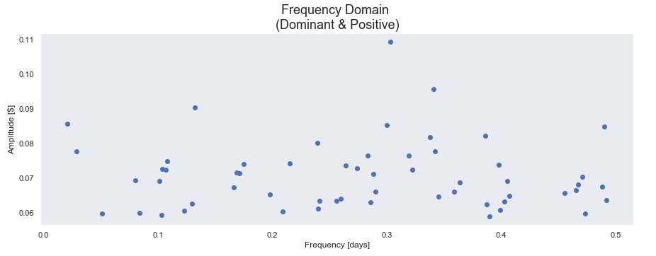
Progress From Week 2 to Week 5
Two thresholds was used to filetted out the less important supervision values:
The amplitude must greater than std_coefficient*std+meanAmplitude
The frequency must be positive

Slide 8
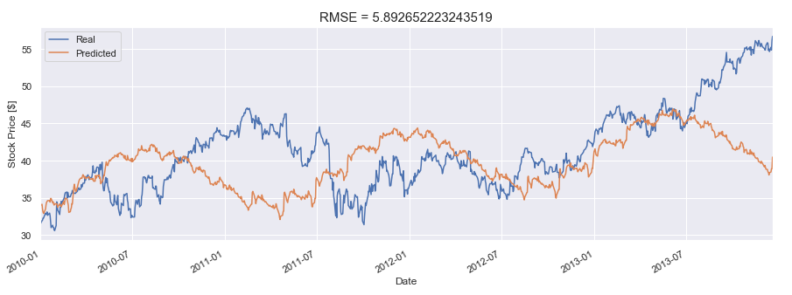
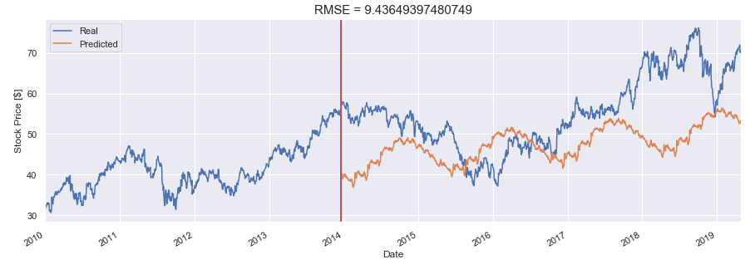
Progress From Week 2 to Week 5

Slide 9
Questions and Next steps
Suggestions of methods to further optimize the prediction
Implemented with machine learning
Lpc find the ness coef dif leng of lpc
Build program examine the stock stationarity
Optimize Fast Fourier Transform performance
Research on Wavelet analysis

